Slide 1
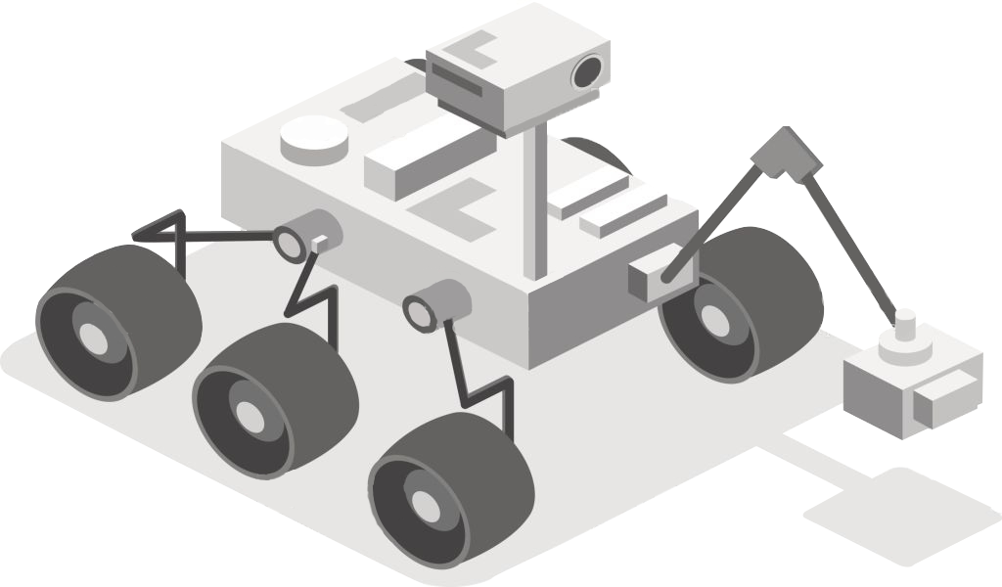
Mars Rover:
Autonomous Navigation
Linden Vo, Tommy Lam, SeungYeun Lee, Daniel Crawley, Brian He
Client: Osama Alshaykh

Slide 2
Project Goals
To design, build, integrate, and test a rover capable of autonomous movement to a specified April Tag with the use of GPS, visual and inertial navigation.

Slide 3
Project Background
Who is this for? University Mars Rover Challenge
Who wants/needs this product?
NASA
Various autonomous vehicle companies
Societal Impact
Opportunities to service and explore unknown terrain
Safely conduct search and rescue operations
Improve reliability of self driving vehicles

Slide 4
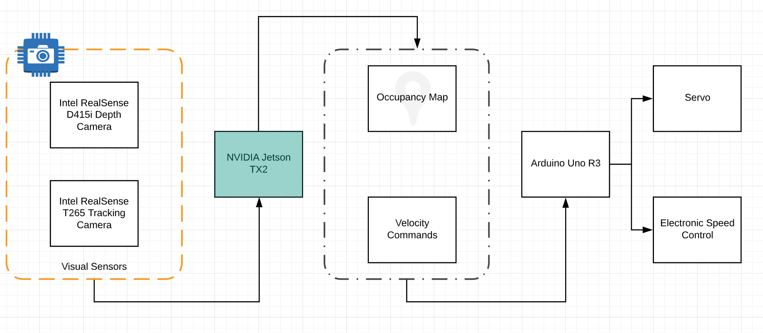
System Architecture
Notes:
Linden

Slide 5
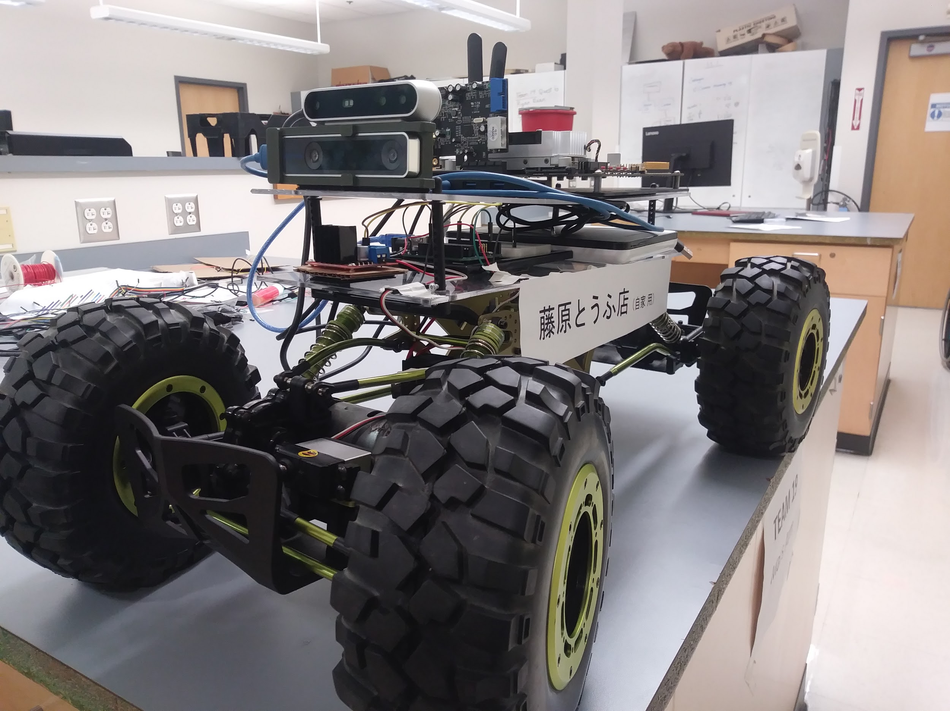
Technical Progress
Hardware assembly and installation complete
Entire navigation stack is up and running but still needs some work
Can navigate autonomously and manually
Highest Priority: Obstacle avoidance has been difficult

Slide 6
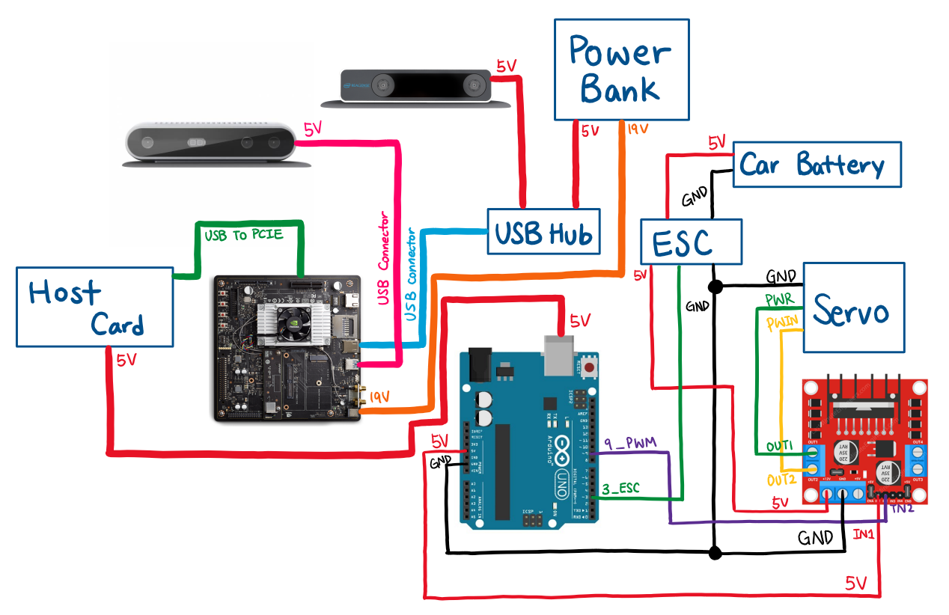
Hardware Schematics
Notes:
Overall Hardware Schematics
Next few slides are broken down into pieces and will explain what each components are for and why we decided to use it

Slide 7
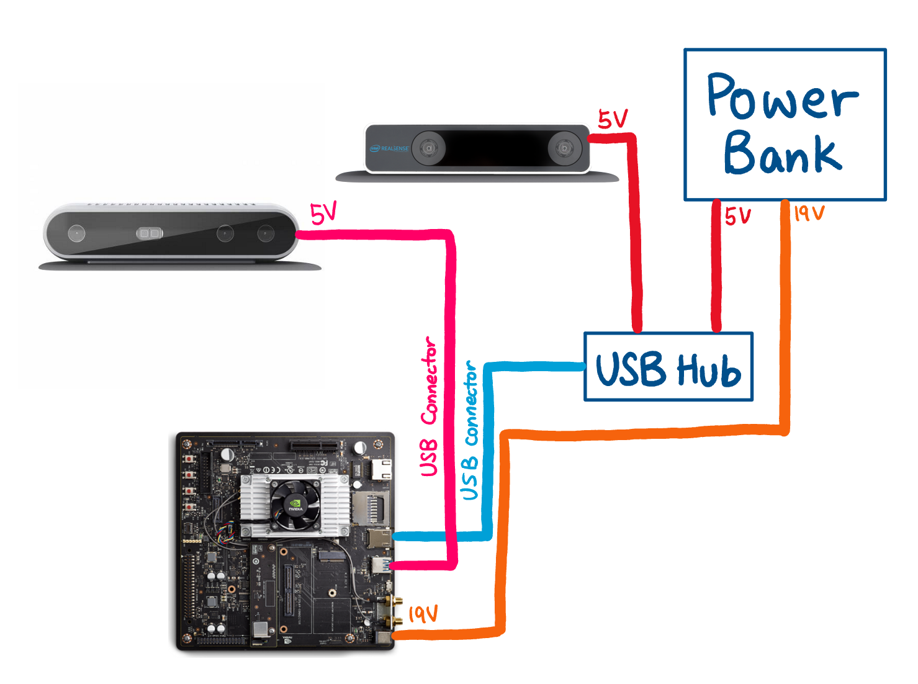
Vision Components
Intel Realsense D415 Depth Camera
I/R sensor is used to make a Depth Cloud
Intel Realsense T265 Tracking Camera
Internal gyroscope gives position and orientation data
Fisheye lense can be used to spot tags at wide angles
Inland Powered USB hub
Additional USB ports for keyboard/mouse, if needed

Slide 8
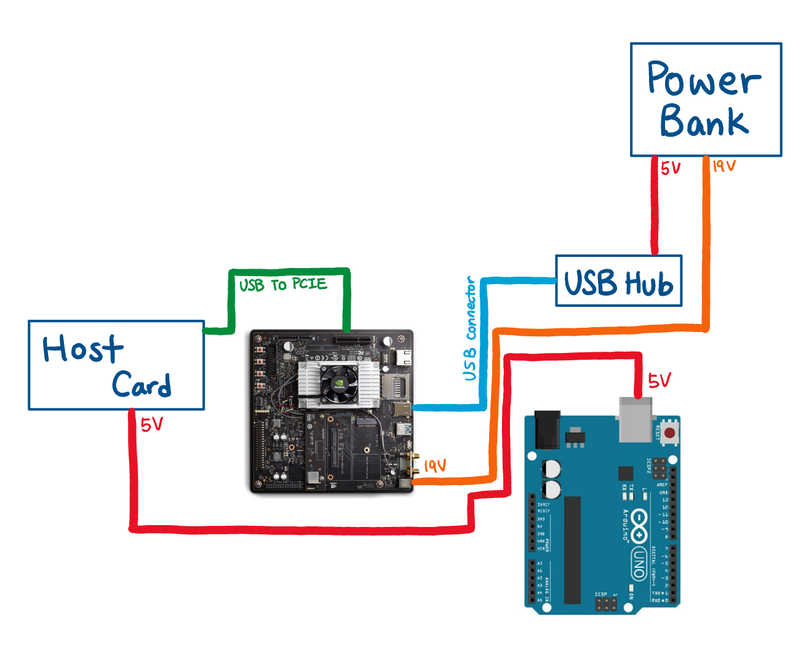
The Brain
NVIDIA Jetson TX2 Dev Kit
6 core ARM CPU and Tegra architecture GPU
Vantec PCIe USB host card
Provides additional USB ports without overloading on-board USB controller
PowerAdd Pilot Pro 2 Battery
Rechargeable, 19V and 5V outputs, 23Ah
Arduino UNO
Low-power board with plenty of PWM outputs

Slide 9
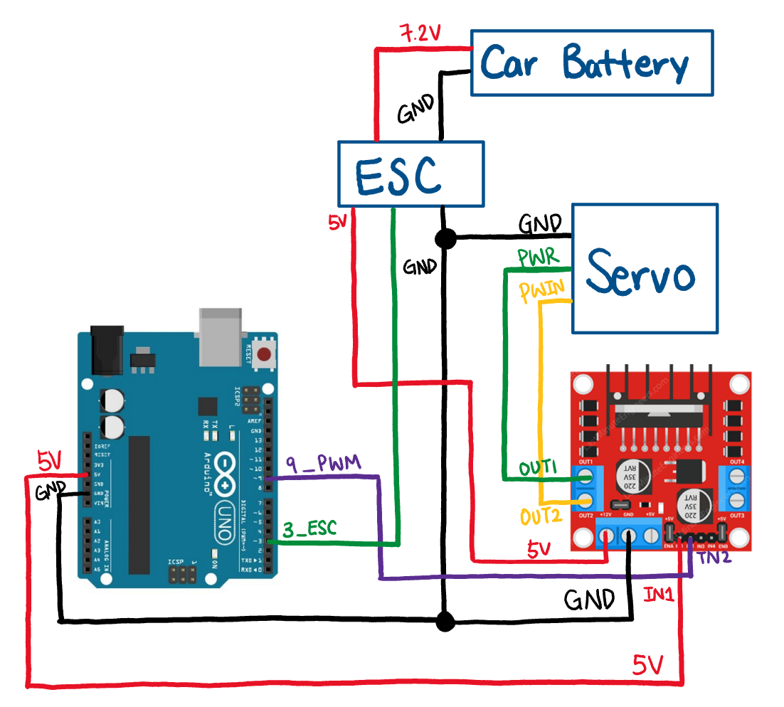
Drivetrain and Steering
“Car” Battery (7.2 V, 2Ah)
Rechargable, built for our ESC
Electronic Speed Control (ESC)
Drives the two stepper motors
Provides power to Motor Driver
Servo ( 9Kg, waterproof)
Turns the front wheels
L298N Motor Driver
Distributes power and PWM signals to servo
Dual Output: can easily add another servo/motor if necessary

Slide 10
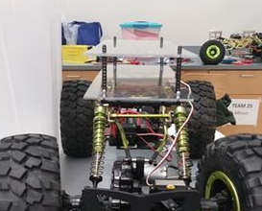
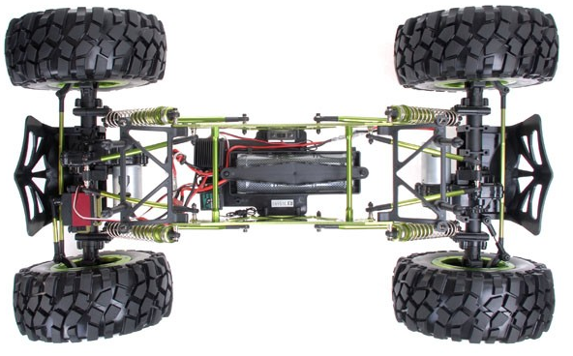
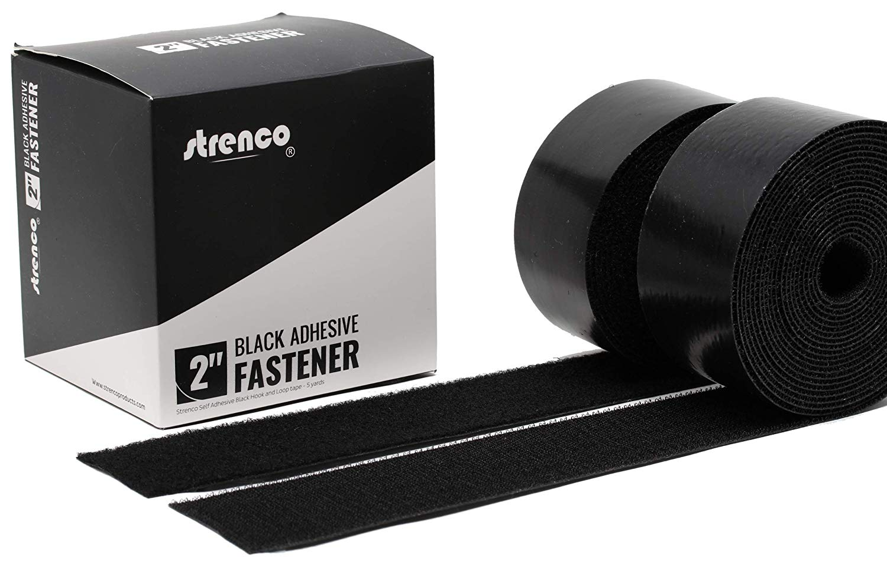
Chassis & Mounting
4WD Crawler
Two stepper motors
Adjustable suspension
Two levels for mounting
2 16”x 10” x ⅛” Acrylic Sheets
2” clearance between levels
Top level is easily removable
Velcro Tape
Items can still be replaced easily
NASA loves velcro, so it makes sense
Notes:
Why do we have a picture of tape lol

Slide 11
Software Stack
1st layer: supports control of the motors, allowing the robot to move forward and turn.
2nd layer: enables the Intel® RealSense™ D415 and T265 cameras.
3rd layer: takes this data and implements SLAM, building a map and localizing.
4th layer: does planning and navigation.

Slide 12
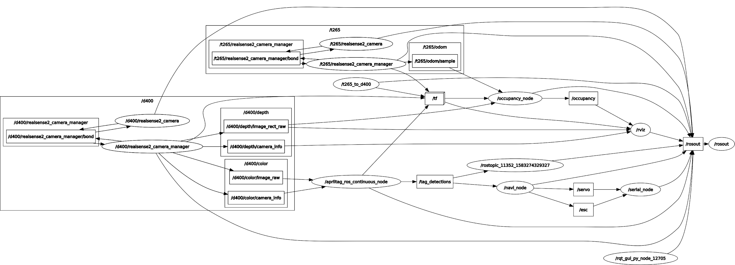
ROS Nodes Diagram (rqt)
Notes:
Linden

Slide 13
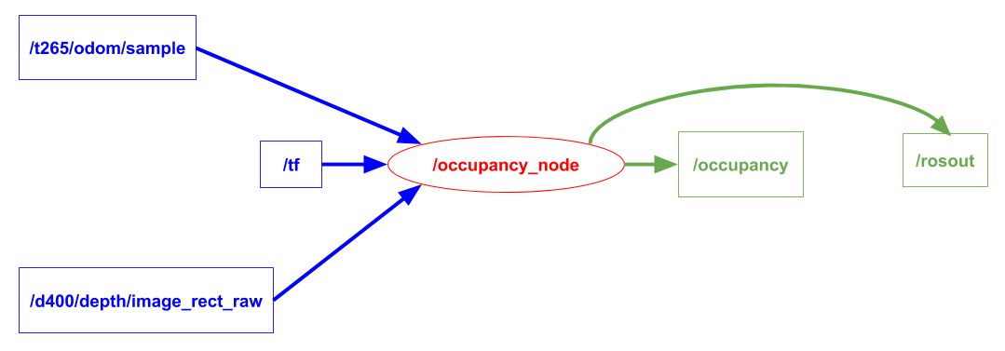
Occupancy Node

Slide 14
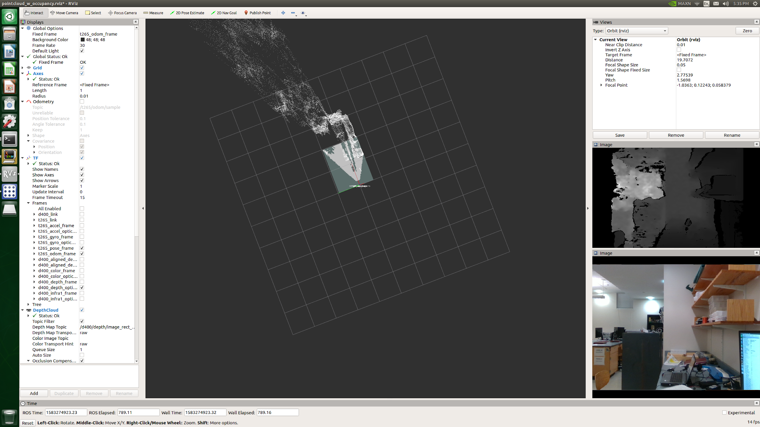
Occupancy Mapping

Slide 15
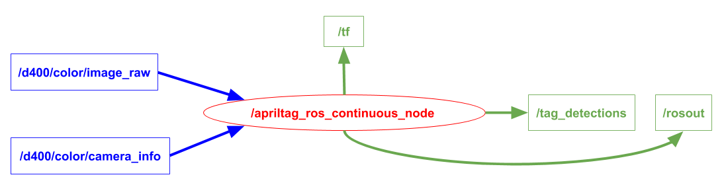
Apriltag Node

Slide 16
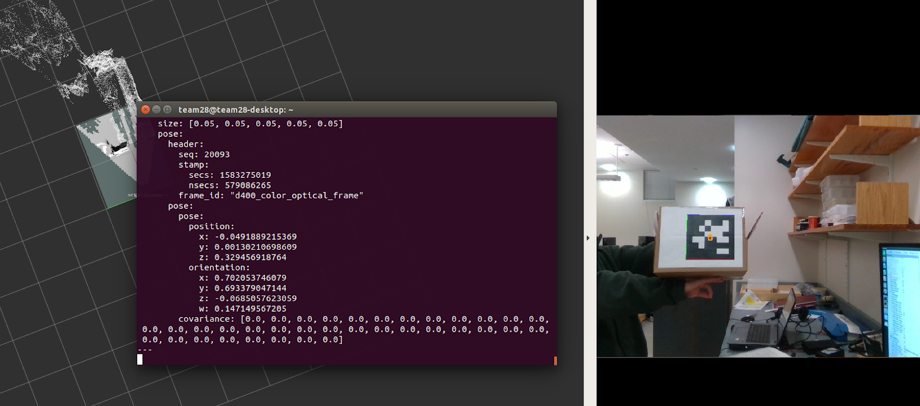
AprilTag Detection/Tracking

Slide 17
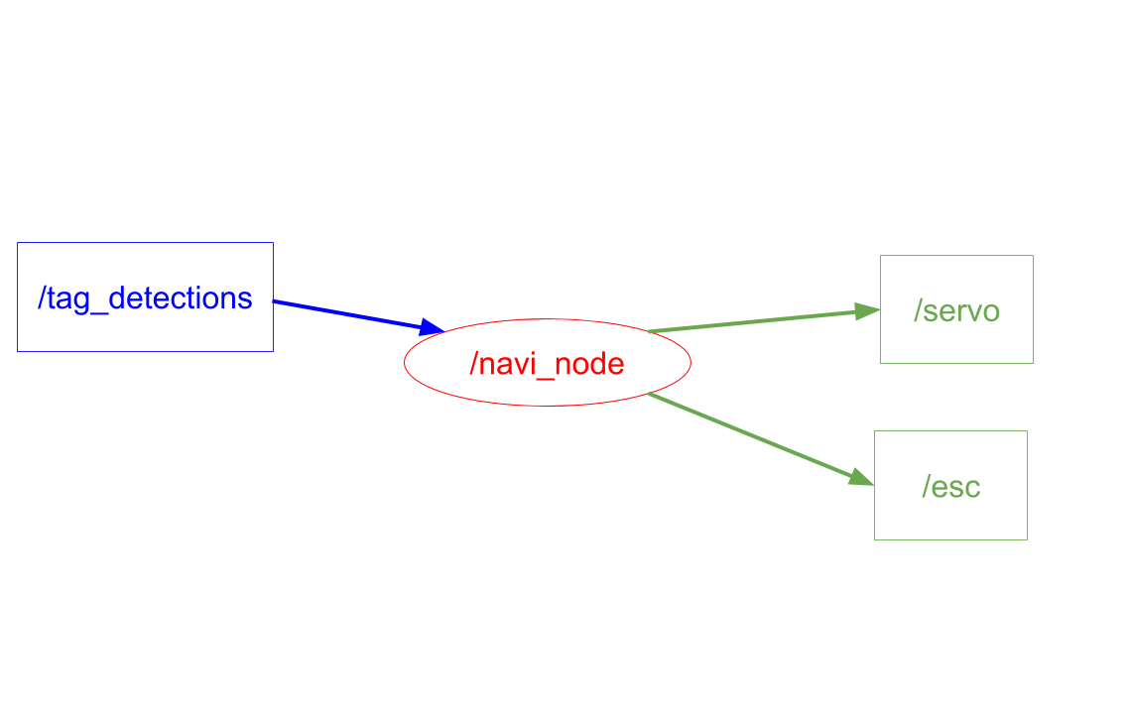
Navigation Node

Slide 18
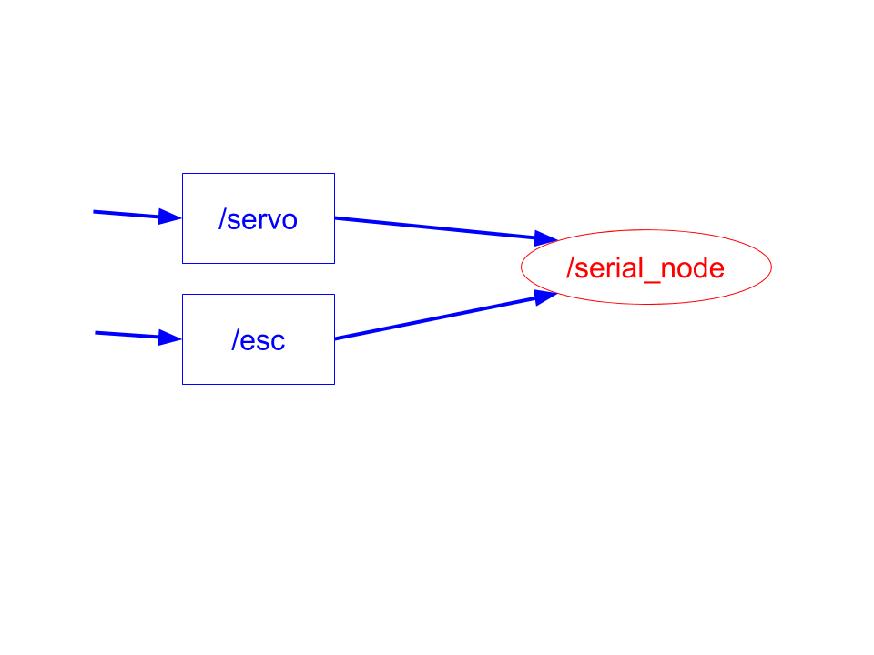
Serial Node

Slide 19
Work Summary for Project Completion
Make rover more robust
Navigate to AprilTag more accurately - fine tuning PID controller
Build modules that control rover movement when AprilTag is not detected
Fix Obstacle avoidance - using slam_gmapping, move_base as part of the ROS Navigation stack
GPS integration
Move to specified point
Provide GPS coordinate or click on map generated in RViz

Slide 20
Mars Rover Competition Requirements
Our Requirements
Substantial goals and constraints
Size and weight restrictions
Specific navigation objectives
Complete an obstacle course
Detect and navigate towards AprilTag
Avoid obstacles
Search for AprilTag when out of sight
Autonomously navigate towards specified location
No restrictions on hardware

Slide 21
Milestones
3/9/20
3/23/20
3/27/20
3/30/20
Optimize navigation
GPS Integration
Final Prototype Test
Finalize obstacle avoidance
Rover stays on path while navigating towards AprilTag.
Rover can detect and navigate around obstacles.
Rover can navigate towards a specified location as directed by GPS coordinates or via a map.
Rover completed.
Notes:
Need for Gantt chart

Slide 22
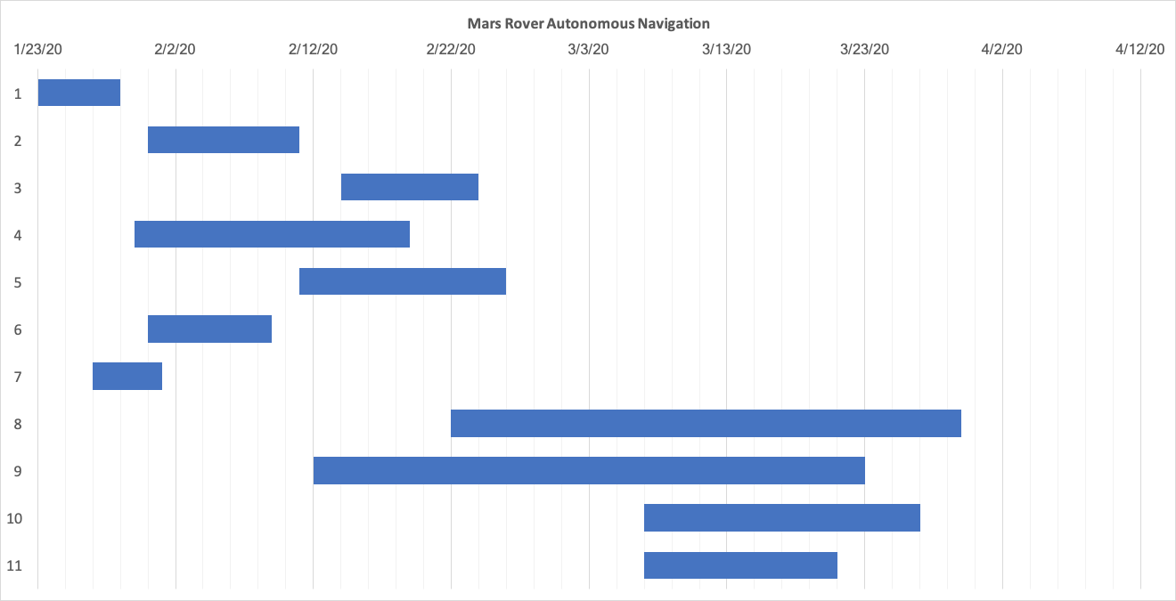
Gantt Chart
Occupancy Map Example
VSLAM
Mounting
April Tag
Data Transmission
Implement Power Strategy
Research TX2 Powering Options
Testing
Obstacle Avoidance
GPS Integration
Improve Navigation Node
Notes:
Linden

Slide 23
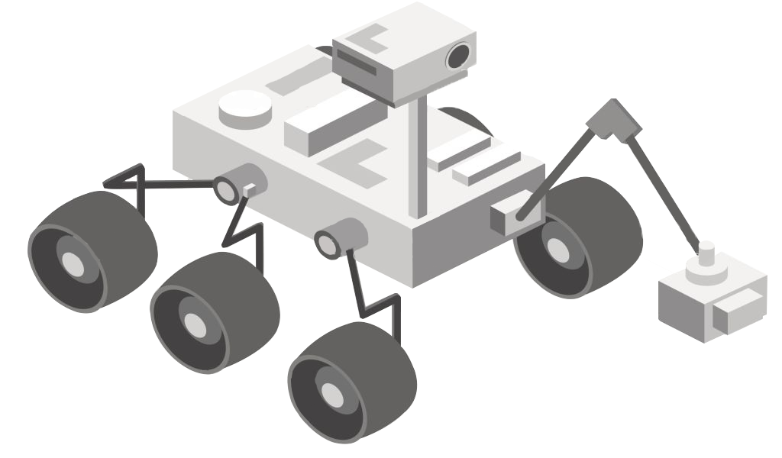
THANKS!
Any questions?

